Slide 1

Sentimental Analysis on Google Play Reviews
Group 7
Caizhen Huang
Shiheng Huang
Yi Huang
Ziqing Liang
Xinfa Pan
Notes:
Hi class we are group 7, and we have Caizhen Huang, Shiheng Huang, Yi Huang, Ziqing Liang and Xinfa Pan in our group, and our presentation is about our analysis on google play reviews.

Slide 2
Introduction
Sentiment Analysis for Google Play reviews
Judge whether an app is good or bad
User can use this model to decide to use which app
Notes:
We are doing a sentiment analysis for Google play reviews, and from the analysis, we want our model to judge whether an application is good or bad so that the users can decide to download and use which app.

Slide 3
Data Description
Notes:
Georeg will present

Slide 4
Data Description
Content
- Google play apps’ reviews
Method
Web Scraping
Data attributes
ReviewId - chr, userName - chr, userImage - chr, Content - chr
Score - int, thumbsUpCount - int, reviewCreatedVersion - chr
At - chr, replyContent - chr, repliedAt - chr, sortOrder - chr, appId - chr
Notes:
The data is about the google play app’s reviews, Google Play is a platform for the public to download different kinds of apps, and people can post reviews and give ratings for the apps.
We scraped app information and reviews using a package called “Google_player_scraper” to scrape the reviews data on google play.
The dataset contains 12 variables that show the details of those reviews. There are 10 categorical variables like reviewId, userName, userImage, Content, and appId. There are 2 numerical variables in the dataset, which are Score and thumbsUpCount.
Before we conducted the analysis on google play reviews, we had to start with cleaning the dataset.

Slide 5
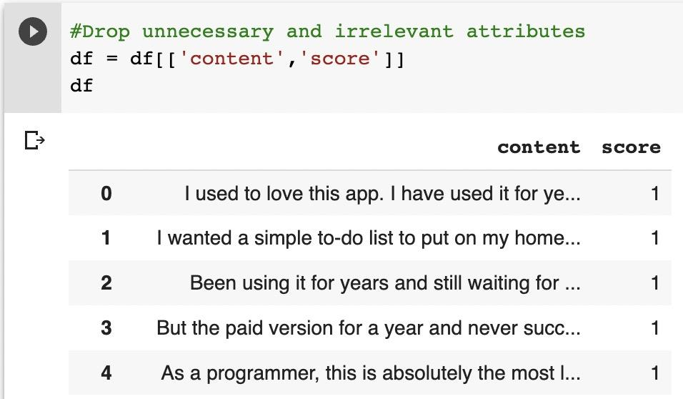
Data Cleaning
Removing irrelevant attributes, Keeping necessary data
Notes:
In this sentimental analysis, we only need two attributes, so that we keep the “content” and “score”
The “content” column contains all the reviews people left for each application, and the “score” column contains the ratings for each app on the platform, and they range from 1 to 5.
The photo shows the data after we Removed irrelevant attributes and Kept the necessary data.

Slide 6
Steps of Approach
Notes:
Here is about the steps of approach for our project.

Slide 7
Our Approach
Preprocessing and Cleaning
2. Text Visualization
3. Sentiment Analysis
4. Sentiment Modeling
Notes:
In order to approach our final goal which presents value advice to the readers. We process through 4 major steps to analyze the Google data. The 4 steps are
Text Preprocessing,
Text Visualization,
Sentiment Analysis,
and Sentiment Modeling.

Slide 8

Text Preprocessing
Standardize all letters
Punctuations
Numbers
Notes:
First of all, we standardize all letters in which we convert all words into the lower case.
After that we Removed all the punctuation marks since that could affect the results of any text processing approach.
And Sama as the punctuation the numbers in the text would affect the text processing results as well, so we convert numbers into words.
The picture show what will change after those 3 steps

Slide 9
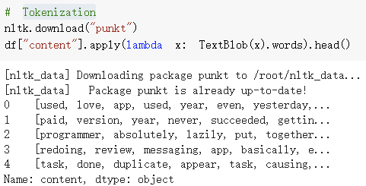
Text Preprocessing
4. Stopwords
5. Rarewords
6. Tokenization
5. Lemmatization
Notes:
In our sencond part for the text preprocesing, we set the english as the stopwords
And remove the rarewords in the content
Also, processces the tokenization and the lemmatization.
The photo show the reuslt after the processed the tokenization.

Slide 10
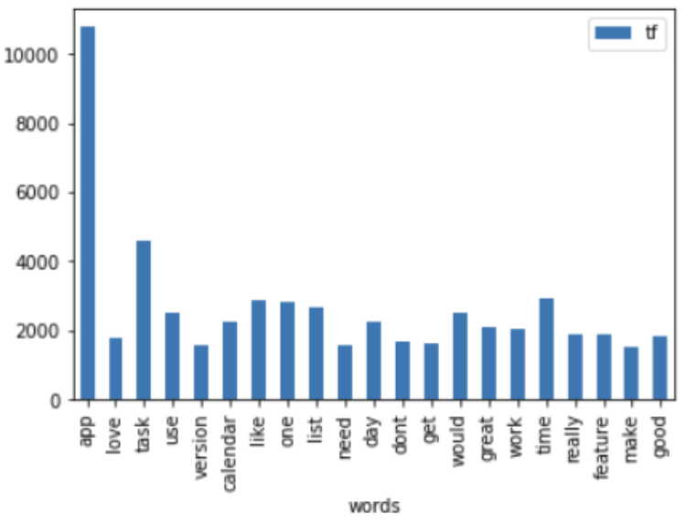
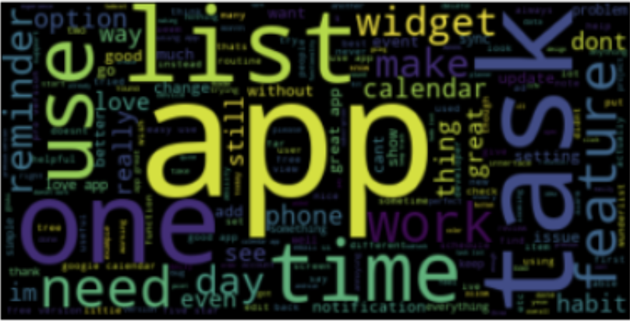
Text Visualization
Calculate the Term Frequencies
Barplot
Wordcloud
Notes:
In this text visualization part, we first calculate the Term Frequencies, to see what are the common words in the user reviews.
In the barplot shows the number one common word is app, and its frequencies is more than 10,000 times, the task is the second high frequencies which shows more than 4000 times, the third high frequencies is the time, it shows around 4000 times.
From the wordcould graph, we can be easy to see the app, task and time in the picture.

Slide 11
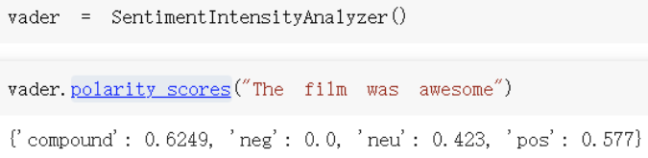
Sentiment Analysis
We used a package called sentiment intensity analyzer. With the feature “polarity score” function inside the package, to analyze the emotion within the app review to try to determine if the app review is positive, negative, or neutral. For instance, if the review is like “the film was awesome”, I will give negative score of 0, neutral score of 0.423, positive score of 0.577, which sums to the total score of 1.
We use this function to get the compound score (aggregated score of the review), positive score, and negative score, and we make them into columns for future use.
Notes:
We used a package called sentiment intensity analyzer for the sentment analysis. With the feature “polarity score” function inside the package, to analyze the emotion within the app review to try to determine if the app review is positive, negative, or neutral. For instance, if the review is like “film was awesome”, we will give negative score of 0, neutral score of 0.423, positive score of 0.577, which sums to the total score of 1.
We use this function to get the compound score which aggregated score of the review, positive and negative, also we make them into columns for future use.

Slide 12
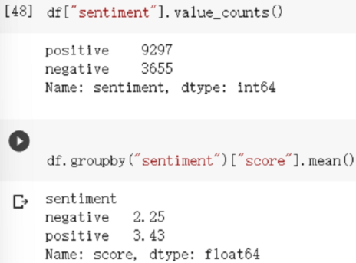
Sentiment Modeling
We created a function for telling if numbers are larger than 0, it will return positive and if numbers are less than 0, it will return negative. A new column named sentiment filled with positive and negative is created based on the vader compound value.
Notes:
In this sentiment modeling part, We created a function for telling if numbers are larger than 0, it will return positive and if numbers are less than 0, it will return negative. A new column named sentiment filled with positive and negative is created based on the compound value.
After have the sentiment modeling, we found out that there are 9297 positive review and 3655 negative reviews in the googles play,
Also, in the score we can found out that 2.25 or below can be determine the app as not worth to download, and 3.43 or higher can be determine as worth to download.

Slide 13
The Models
Notes:
Peter will present next part for the models

Slide 14
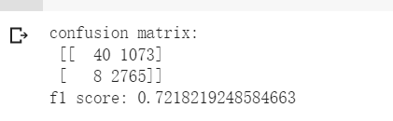
Naive Bayes Multinomial

Slide 15
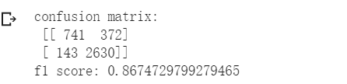
Logistic Regression

Slide 16
Challenges & Learnings
Notes:
Caizhen will present.

Slide 17
Challenges & Learnings
Challenges:
Sarcasm
Emojis
Idioms
Learnings:
tfidf
Polarity score
Notes:
People use irony and sarcasm on social media. The act of expressing negative sentiment using backhanded compliments can make it difficult for sentiment analysis tools to detect the true context of what the response is actually implying. This can often result in a higher volume of “positive” feedback that is actually negative.
NLP tasks are trained to be language specific. While they can extract text from even images, emojis are a language in itself. Most emotion analysis solutions treat emojis like special characters that are removed from the data during the process of text mining. But doing so means that companies will not receive holistic insights from the data.
Machine learning programs don’t necessarily understand a figure of speech. For example, an idiom like “not my cup of tea”, the algorithm will not analyze it correctly
Learning:
Learned to use the frequency of words to determine how relevant those words are to a given document.
Learned to use polarity score to classify whether the review is positive or negative
use sentiment analysis on the review to help people make better decisions when downloading the apps from google play.
Machine learning programs don’t necessarily understand a figure of speech. For example, an idiom like “not my cup of tea”, the algorithm will not analyze it correctly

Slide 18
Q&A
Thank You

